Slide 1
Part 9 ORM in Django Part-2
VERSION: 4.0.1
WRITTEN AND DESIGN BY: BABAR ALI

Slide 2
Django Model Field Types
BooleanField:
present = models.BooleanField(default=False)
CharField:
present = models.CharField(max_length=120)

Slide 3
Date Field In Django Model
Date Field:
class DateField(auto_now=False, auto_now_add=False, **options)
A date, represented in Python by a datetime.date instance. Has a few extra, optional arguments:
DateField.auto_now:
class DateField(auto_now=False, auto_now_add=False, **options)
A date, represented in Python by a datetime.date instance. Has a few extra, optional arguments:
DateField.auto_now_add:
Automatically set the field to now when the object is first created. Useful for creation of timestamps. Note that the current date is always used; it’s not just a default value that you can override.

Slide 4
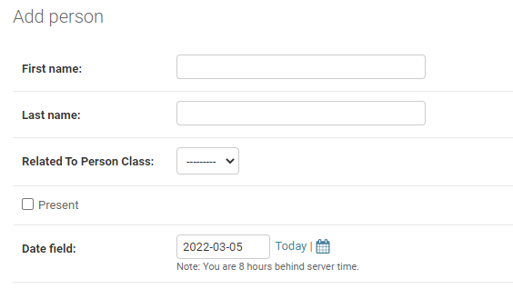
DateField Example
date_field = models.DateField(auto_now_add=False)

Slide 5
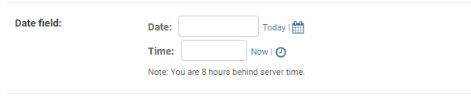
DateTimeField Example
date_field = models.DateTimeField(auto_now_add=False)

Slide 6

Email Field
A CharField that checks that the value is a valid email address using EmailValidator.
User_email = models.EmailField()

Slide 7

File Field
A file-upload field.
upload_CV = models.FileField(upload_to=None, max_length=100)

Slide 8
Image Field
Inherits all attributes and methods from FileField, but also validates that the uploaded object is a valid image.
Upload_img = models.ImageField(upload_to=None, height=None, width=None)

Slide 9

Integer Field
An integer. Values from -2147483648 to 2147483647 are safe in all databases supported by Django.
contact = models.IntegerField()

Slide 10
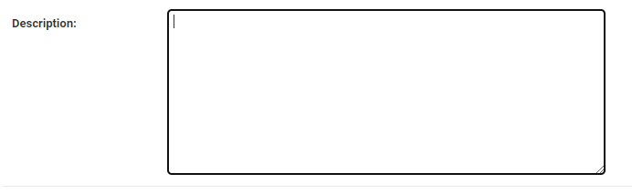
Text Field
A large text field. The default form widget for this field is a Textarea.
description = models.TextField()

Slide 11

Time Field
A time, represented in Python by a datetime.time instance. Accepts the same auto-population options as DateField.
Pick_time = models.TimeField(auto_now_add=False)

Slide 12
Thanks for Reading

